Slide 1


Session 11. Services and COB in T24
T24 Technical Induction Training
Minsk, 2021

Slide 2





Agenda
Services Overview. Units of Services: Process and Job. Services settings. Multi-threading. Services executing and stopping. Auto Services. Scheduling of Services. COB Overview and Stages. COB and Non-Stop Processing. COB Monitoring and Errors

Slide 3
T24 Services
T24 Services

Slide 4


T24 Services Overview
Help in automation
Services are programs that are run as background processes without user intervention
Can be executed at a schedule and can also be triggered by a manual activity
They spawn multiple processes simultaneously and are centrally monitored by T24
Catalogued in TSA.SERVICE application

Slide 5
Services – An Example
ABC Industries needs to pay salary to its employees on the 31st of every month
All employees of ABC Industries have accounts with Bank B
Bank B maintains a file that is sent from ABC Industries and this file has the names and salary details of the employees
A service needs to be triggered on 30th of every month by the Bank, to debit the company account and credit the employees account with the salaries

Slide 6
Units of a service
Process
A set of jobs that perform a business function – for example, the payment service
Service Processes in T24 are catalogued in the BATCH application and consist of a set of jobs
Job
The lowest unit of work

Slide 7
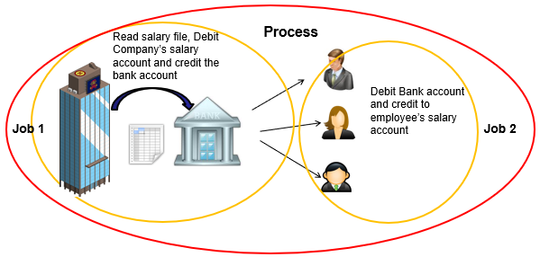
Process and Jobs
The service needs to do the following:
Read the employee file details and determine whether the file is valid, all employee accounts are valid
Debit the company’s account and move funds into a bank account
Debit the bank account and credit salaries to the individual employees

Slide 8
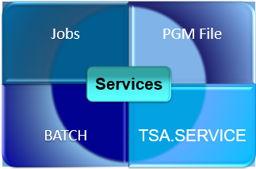
Setting up a Service
A group of multithreaded routines or jobs
These routines are catalogued in PGM.FILE
Processes are catalogued in BATCH
Trigger to start the service is catalogued in TSA.SERVICE – Id identical to BATCH record Id
Notes:
Each multi threaded routine in T24 must have a PGM.FILE entry with TYPE = B which stands for BATCH.
Each B type routine has an entry in the BATCH application, and a service is no different. A service could be made up of one multi threaded routine or multiple routines that must be run in an order. You will use the BATCH record to define this order using the JOB field. The BATCH record that you will create will NOT have a BATCH.STAGE defined as this record must NOT be picked up during COB.
Finally, you must create a record in the application TSA.SERVICE. The ID of the record must match the BATCH record Id. Why is this? – This is because when you start off a service, T24 looks for a record in the BATCH application and then finds out which routine it must execute in the background.

Slide 9
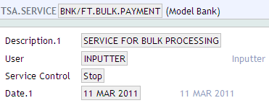
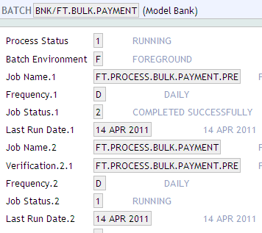
The payments Service
Let us look at an example, discussed earlier.
FT.BULK.PAYMENT is the service used for bulk payments processing. Take a look at the
jobs within the process:
Company (branch) mnemonic is a part of ID
Jobs should be
catalogued in PGM file
Notes:
In this example, an existing service called BNK/SWIFT.OUT is used. The screen shots above show the identical TSA.SERVICE and BATCH record Ids.
From the BATCH record, you can find out the actual name of the multi threaded routine and check it’s PGM.FILE entry
It is important to understand - Why the Bank Mnemonic is part of the BATCH record ID?
This is because all processes are company specific. If we want the same process to be executed for each company defined in the COMPANY application then we have to have processes defined for every company separately.
For Example:
A company with mnemonic BNK might want a process to run during COB whereas another company with mnemonic EU1 might not want the same process to run during COB. The only way to do this in T24, is to create a process in the BATCH application with ID prefixed with the mnemonic BNK and not EU1.
BNK/<Batch Process ID Name>
If you want this batch process to be executed for both BNK and EU1, then you need to do the following. Create the following records in the BATCH application
BNK/<Batch Process ID Name>
EU1/<Batch Process ID Name>

Slide 10
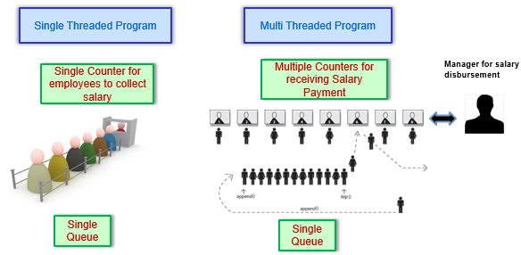
Multi – threading in a Job
A Service is executed as a multi-threaded process. Let us understand this with an example:

Slide 11
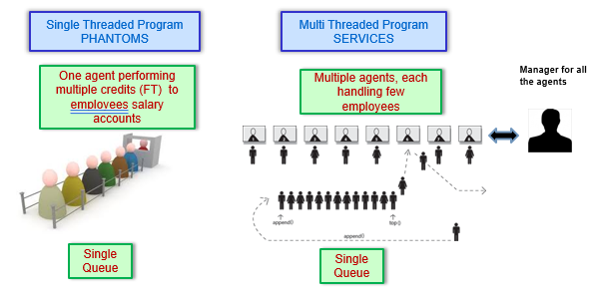
Execution of a service - Illustration
Let us look at it in T24 Terms:

Slide 12

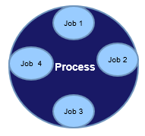
BATCH
What?
A Batch, in general, is a set of items grouped together
It is an application where programs are grouped together based
on logic
Each record in batch is referred to as a “Process”
Programs in a BATCH are referred to as “jobs”, that perform a specific task
Processes are catalogued in BATCH application
Notes:
Each multi threaded routine in T24 must have a PGM.FILE entry with TYPE = B which stands for BATCH.
Each B type routine has an entry in the BATCH application, and a service is no different. A service could be made up of one multi threaded routine or multiple routines that must be run in an order. You will use the BATCH record to define this order using the JOB field. The BATCH record that you will create will NOT have a BATCH.STAGE defined as this record must NOT be picked up during COB.
Finally, you must create a record in the application TSA.SERVICE. The ID of the record must match the BATCH record Id. Why is this? – This is because when you start off a service, T24 looks for a record in the BATCH application and then finds out which routine it must execute in the background.

Slide 13
BATCH – Features
Frequency
- D
- D nn
- W
- M
- M nn
- Y
- Y nn
A
SW -SM -SY
Notes:
BATCH.ENVIRONMENT
Defines the environment to run the process in, i.e foreground or background
A foreground process will be run directly on the users terminal, whereas a background process will run as a phantom task. The background facility allows the user to run a number of processes concurrently.</p>
2. Job Name Contains the name of the routine to be executed. All routines defined here will have an entry in PGM.FILE with TYPE set to ‘B’
3. Frequency specifies the frequency at which the batch job has to be executed. It can have values as follows.
D specifies that the job will be executed every working day.
D nn specifies that the job will be executed every nnth working day
W specifies that the job will be executed on a weekly basis, that is every Friday
M specifies that the job will be executed on the last working day of every month
M nn specifies that the job will be executed every nn day of the month or previous working day of each month
Y specifies that the job will be executed last working day of the year
Y nn specifies that the job will be executed the last working day of the nn'th month
A specifies that the job will be executed on an adhoc basis. You should manually specify a date on which the job has to be executed.
SW specifies that the job will be executed every start of WEEK SM specifies that the job will be executed every start of Month SY specifies that the job will be executed every start of Year

Slide 14
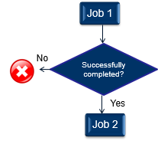
BATCH – Setting dependency
Notes:
In the field Verification, you can enter the name of the job (routine) which needs to have been executed successfully on that day before the current job is executed. For e.g. The job FT.PROCESS.BULK.PAYMENT will be executed only if the job FT.PROCESS.BULK.PAYMENT.PRE has been executed successfully.
NOTE: Only jobs already defined in the current record can be entered in the field Verification. Jobs belonging to other Processes (Batch Records) cannot be entered in this field.
2. Next Run Date contains the date when the current job has to run next. Populated automatically on authorisation of the record (new jobs) or on successful execution of the job. NO date is populated for Daily jobs, as the jobs needs to be run daily. User input is required for adhoc jobs.
3. Last Run Date is a No Input Field and is populated on successful execution of the job during COB.

Slide 15
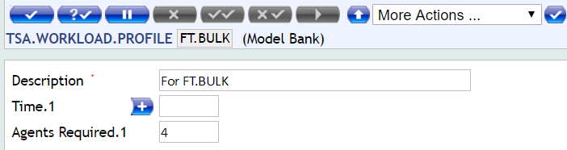
TSA.WORKLOAD.PROFILE
Application TSA.WORKLOAD.PROFILE is used to set up the number of agents that are launched when service is working
Notes:
This is the application used to specify the number of agents. The number of agents in TSA.WORKLOAD.PROFILE can be set based on time. Agents can be increased/decreased based on time (T24 application server time)
Assume a scenario where in you know that the server will be busy at 11PM as that is when transactions from an interface will be coming in. You may choose to reduce the number of agents running COB during that period so that the server be used for the interface as well. Define this in the TSA.WORKLOAD.PROFILE application.
TSA.WORKLOAD.PROFILE is the application which defines the number of tSAs required. The ID of a record in this application can be any alphanumeric text.
The number of agents in TSA.WORKLOAD.PROFILE can be set based on time if required.
TIME and AGENTS.REQUIRED : These fields are associated multi value set which holds the specific time and the number of agents required at that point in time.
The number of agents that can run on server is directly proportional to the number of processors available. Just because T24 supports multi threaded services doesn’t mean you can start a 100 tSA’s in the background. It will kill the server. The thumb rule to be followed is a maximum or 2 tSA’s per processor available.

Slide 16
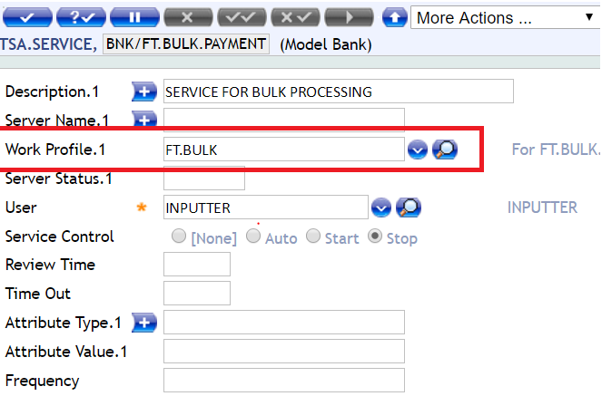
TSA.SERVICE
Notes:
TSA.SERVICE is the application where all services are defined and controlled by the end user.
ID: The id of the service record must match a record in the BATCH application.
DESCRIPTION : This field holds the description of what the service is used for.
SERVER NAME : This field holds the IP address or the host name of the server where the current service needs to be executed. This will be used on in a multi application server architecture.
The whole idea behind a service is that you will have multiple copies of the process running so that the load can be shared. How many such copies do you want running? That is defined in the field WORK PROFILE. This field holds the ID of the record in TSA.WORKLOAD.PROFILE application which defines the number of copies that will actually execute.
USER : This field should hold a valid T24 user name, whose details are used to update the audit fields of records that get created or updated by the service.
SERVICE CONTROL : This field can hold three values – AUTO, START and STOP. STOP can be set in this field to stop the service when it is executing.
You will learn about the other fields in the next few slides.

Slide 17
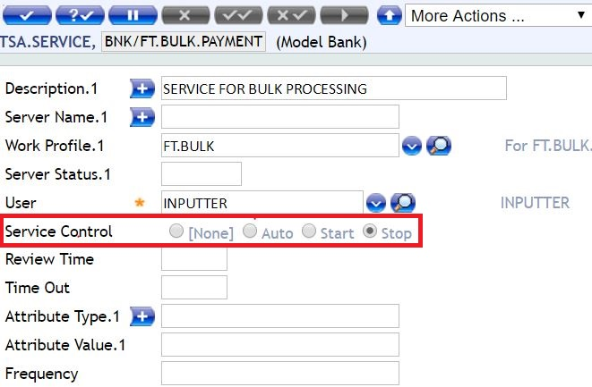
Start / Stop a service
To start a service in T24, the TSA.SERVICE record must be edited and the field SERVICE.CONTROL set to START or AUTO
Then tSM (service manager) must be started:
Also in TSA.SERVICE application, in record tSM field SERVICE.CONTROL must be set as ‘start’, then command START.TSM in Command Line jbase (jsh prompt)
Notes:
You must first turn the service on using the SERVICE.CONTROL field in TSA.SERVICE. This change must be authorised. You must remember that this action does not start off the service in the background. Its only a flag to say that the service will be picked up and executed.
You must then start the tSM program. This can be done only from the jBASE prompt. This will cause all service records with either START or AUTO to be picked up to be started.

Slide 18
T24 COB
T24 COB

Slide 19
COB - Close Of Business
COB stands for Close Of Business
Marks the end of all financial transactions for the day and rolls forward the T24 date to the next business day
COB can be run on every working day of the bank
Notes:
1. COB stands for Close Of Business
2. COB marks the end of all financial transactions for the day and rolls forward the T24 date to the next business day
3. COB can be run on every working day of the bank
Let’s understand one of the processes done during COB with a simple example
Steve has taken a loan from a bank at a 10% rate of interest, payable back to the bank in a year. This amount will be paid by him in 12 monthly installments. The bank would like to keep a daily track of the interest amount they are due to receive from Steve at the end of the month. So, they calculate the amount payable by him everyday. This is done to keep the Profit and Loss/Balance sheet current. Now, this is just for one customer. Imagine the bank has given 100,000 loans with different interest rates for different periods of time to individuals like Steve. It’s an arduous task for the bank to do the whole process manually. So, they automate it. However the amount payable to the bank need not be calculated during normal working hours of the bank (because they will be busy doing other day to day activities of the bank). So they do it at the end of the day. The process of calculating the interest payable, but not yet fallen due for payment, is called Accrual. Therefore, accrual is one of the processes that is done during T24’s COB (Close of Business)

Slide 20
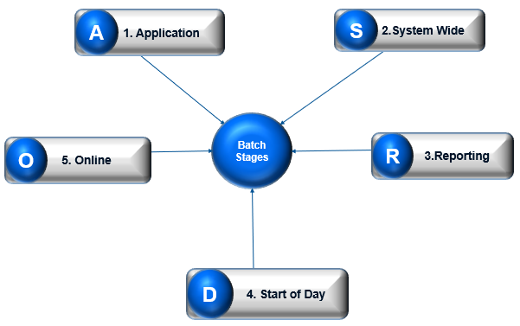
Stages of COB
Notes:
COB runs in five stages, A-S-R-D-O
A stands for Application stage. It involves all the individual application processes. Eg: Forex, Funds Transfer, etc.
S stands for System Wide stage. It involves jobs that are common to T24. Eg: Interest accrual, Interest capitalization
R stands for Reporting stage. It involves generation and printing of reports. Eg: Trial Balance, Transaction journal etc.
D stands for Start Of Day stage. It involves all the start of day operations and date change. Eg: Executing standing orders etc.
O stands for Online stage. It involves any non-critical reports and processes which can be run after the system has returned to online mode. Eg: Jobs to clean up of temporary work files, etc.

Slide 21
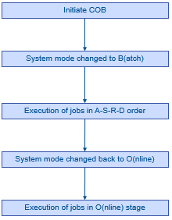
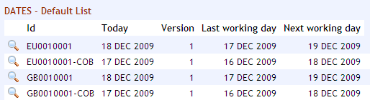
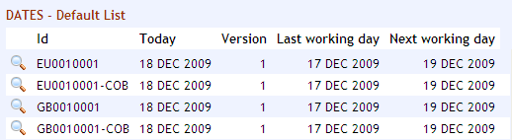
COB – High Level Overview
Reflected in the DATES application
Reflected in the DATES application
Notes:
When you initiate COB, either in debug mode or interactive mode
The System Mode is changed from Online mode to Batch mode. This is reflected in the DATES application. This is to indicate that COB is currently running on the system
The Execution of COB jobs take place in A, S, R, D order
The System is changed to Online mode at the start of “O” stage of COB. This is also reflected in the DATES application
Finally all the jobs in the online stage are completed.

Slide 22
Non Stop (NS) Module
COB supports 24 hours non stop processing
For this a product named NS (Non Stop) needs to be installed
When NS is installed, the T24 system will be available for input when COB is in progress
All transactions when input during COB, will have the value day as next working day.
E.g.: If we input a FT when COB is running on 10 JAN 2019, the value date for the transaction will be taken as 11 JAN 2019.
Notes:
COB supports 24 hour non stop processing
1.1 For this a product named NS (Non Stop) needs to be installed
1.2 When NS is installed, the T24 system will be available for input when COB is in progress
1.3 It uses the DATES record with @ID - <Company.Code>
1.4 Therefore, all transactions when input during COB, will have the value day as next working day.
Eg: If we input a FT when COB is running on 10 JAN 2010, the value date for the transaction will be taken as 11 JAN 2010

Slide 23
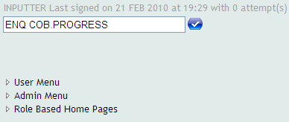
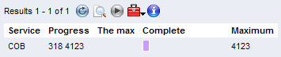
COB Monitor - Enquiry COB.PROGRESS
Notes:
318 OUT OF 4123 JOBS HAVE BEEN PROCESSED
Progress Bar displaying % completion
While executing the enquiry, you can set the Auto Refresh Option, this way the enquiry will keep refreshing and showing you the % of jobs completed.

Slide 24
COB Errors - EB.EOD.ERROR
Is there a file where all the errors encountered during COB can be viewed?
Yes. The name of the file is EB.EOD.ERROR
The id to a record in EB.EOD.ERROR is <company.code>.<date>
Eg: GB0010001.20190120
EB.EOD.ERROR contains one record per company per day running COB. The details of the individual errors can be found in a file called EB.EOD.ERROR.DETAIL
The id to record in EB.EOD.ERROR.DETAIL application is present in the record of EB.EOD.ERROR
Notes:
Is there a file where all the errors encountered during COB can be viewed?
1.1 Yes. The name of the file is EB.EOD.ERROR
The id to a record in EB.EOD.ERROR is <company.code>.<date>
1.1 Eg: GB0010001.20100120
EB.EOD.ERROR contains one record per company per day running COB. The details of the individual errors can be found in a file called EB.EOD.ERROR.DETAIL
The id to record in EB.EOD.ERROR.DETAIL application is present in the record of EB.EOD.ERROR

Slide 25
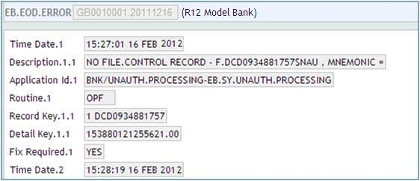
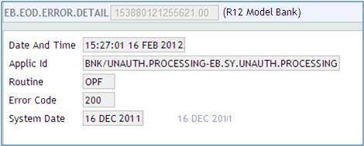
COB Errors - EB.EOD.ERROR
Notes:
Once you list the records present in the application EB.EOD.ERROR you will be able to see records that are date and company specific. All errors encountered as a result of running COB on a single day are stored in 1 record. If multiple errors are recorded during the same day, they are stored in the same EB.EOD.ERROR record but multivalued.
Each error has a Detail Key populated against it which is nothing but the ID to the application EB.EOD.ERROR
For every error encountered during COB (for that day) there will be a equivalent record in the application EB.EOD.ERROR.DETAIL.
The application EB.EOD.ERROR.DETAIL will contain the name of the Process, the name of the job and the routine from which the error was generated
The ID to a record in this application is held in the EB.EOD.ERROR file. The main use of this application is to track down the cause of the problem encountered during COB. This helps the consultant in fixing the problem before starting COB the next time.

Slide 26
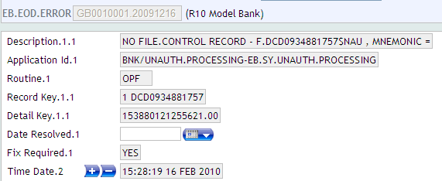
COB Errors - EB.EOD.ERROR
How do we tell T24 that an error has been resolved?
Notes:
COB cannot run the next day without resolving errors encountered during the previous run.
Q. How do we tell T24 that an error has been resolved?
A. Open the corresponding record in EB.EOD.ERROR in EDIT mode and set the field Date Resolved to the date when the error was fixed. Commit and authorise the record. This has to be done before COB is started the next day

Slide 27
Thank you for your time and attention!
FORANX LLC
Legal address:
35A, Ponomarenko str., 201 office, Minsk, 220015, Belarus
Tel.:+ 375 17 202 76 78
+ 375 17 202 76 79
Fax: + 375 17 362 34 22
E-mail: z.zhogun@foranx.by
Web-site: www.foranx.by
Tel Aviv, 2021

